Slide 1
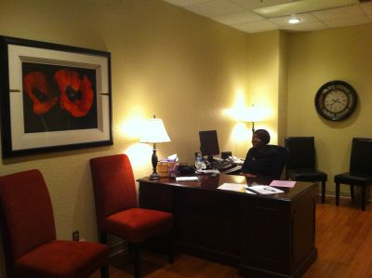
Academic Advising and Student Services Center
Advising and Career Counseling
Degree Plans
Major Changes
Graduation Plans
Late Adds and Reinstatement
Resource Room
Room 127

Slide 2
Academic Advising Center Activities
Hosted a TEXAAN Conference
NACADA Conference
STEM Major’s Fair
Summer Orientation
Showcase Saturday
Convocation
September 5th @ 4:30pm

Slide 3
Academic Advising and Student Services Center Update

Slide 4
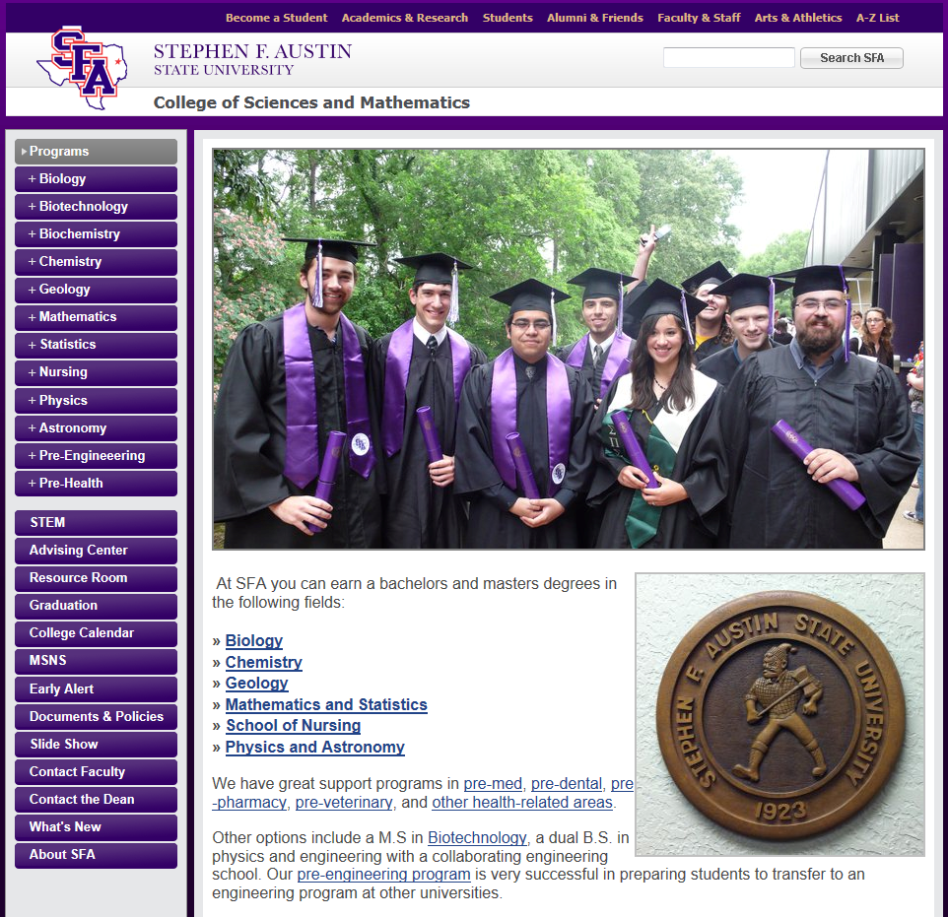

Slide 5
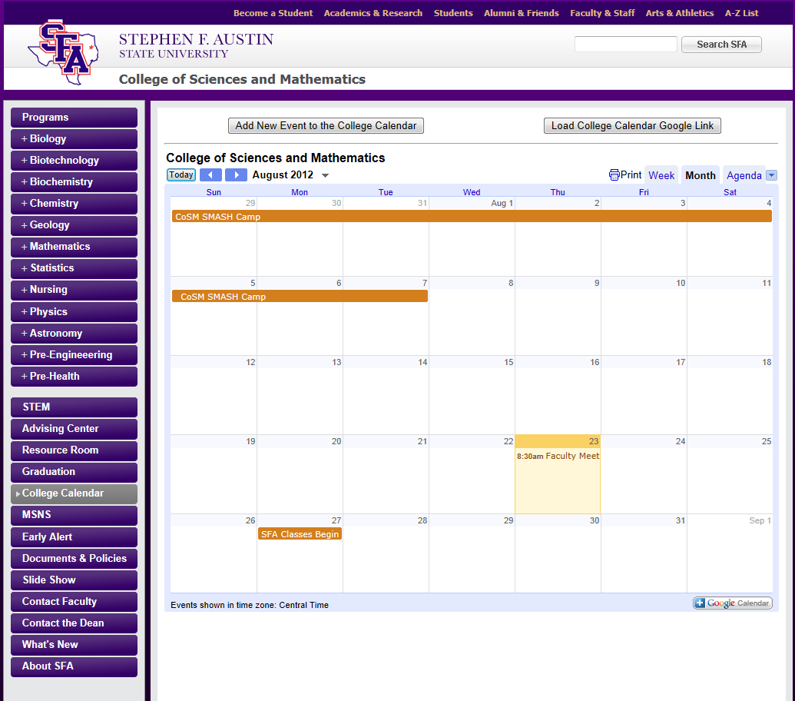

Slide 6
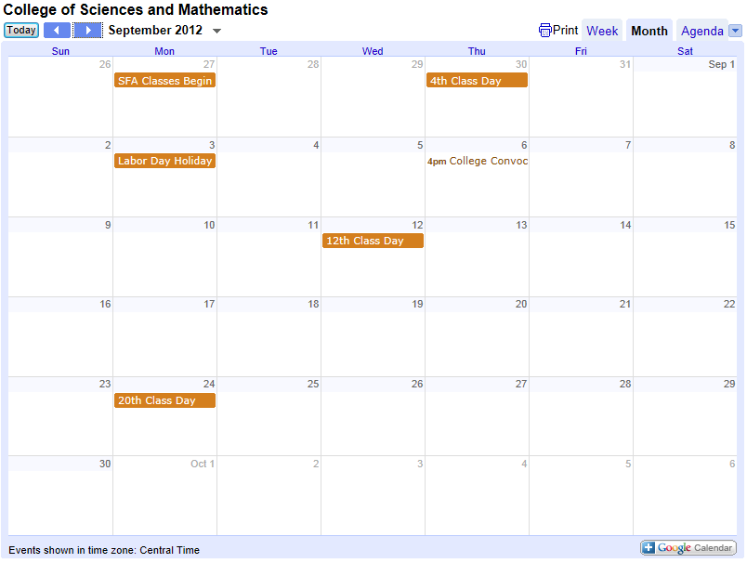

Slide 7
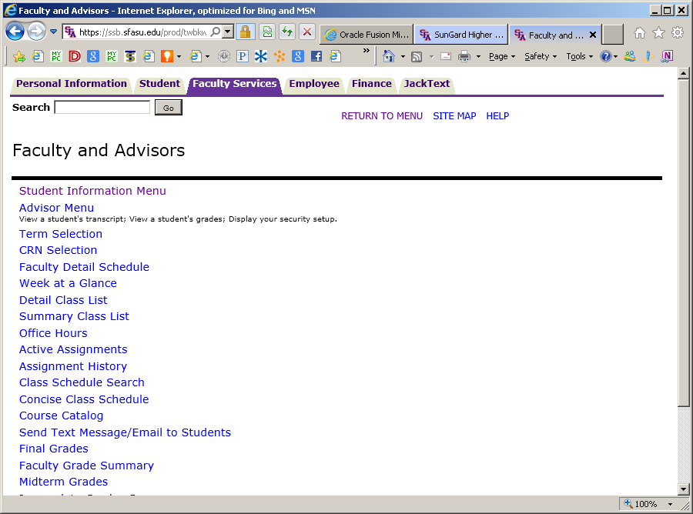
F.E.R.P.A.
Family Educational Rights and Privacy Act

Slide 8
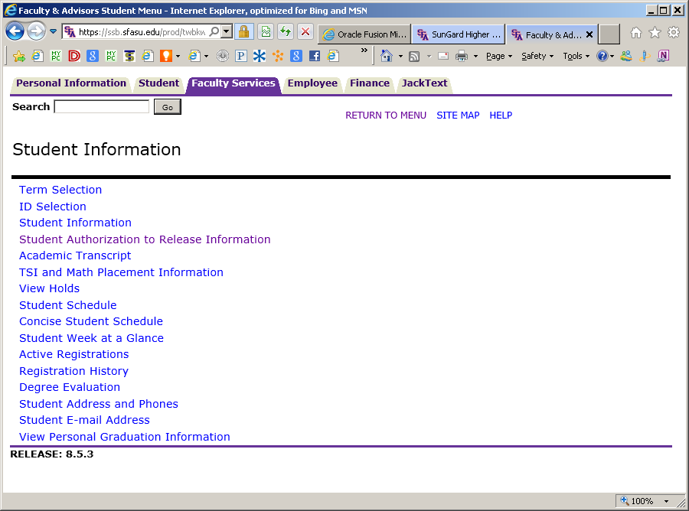
F.E.R.P.A.
Family Educational Rights and Privacy Act

Slide 9
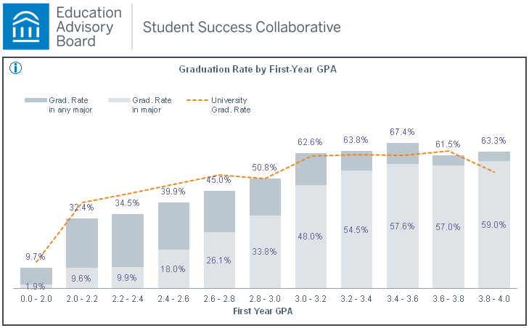

Slide 17
Welcome Back!
Fall 2013

Slide 18
Introductions by Departments
Biology – Dr. Dennis Gravatt
Chemistry and Biochemistry – Dr. Michael Janusa
Geology – Dr. Kenneth Farrish
Mathematics and Statistics – Dr. Debbie Pace
Nursing – Dr. Glenda Walker
Physics and Astronomy – Dr. Harry Downing

Slide 19
Congratulations!
Promotion to Professor
Dr. Lesa Beverly – Mathematics and Statistics
Dr. Roy Joe Harris – Mathematics and Statistics
Dr. Sarah Stovall – Mathematics and Statistics

Slide 20
Congratulations!
Tenure and Promotion to
Associate Professor
Dr. Brian Beavers – Mathematics and Statistics
Dr. Jeremy Becnel – Mathematics and Statistics
Dr. Wesley Brown – Geology
Dr. Matthew Kwiatkowski – Biology
Dr. Kefa Onchoke – Chemistry and Biochemistry
Dr. Kent Riggs – Mathematics and Statistics

Slide 21
Congratulations!
College Teaching Excellence Award 2012
Dr. Clint Richardson
SFA Alumni 2012
Distinguished Professor Award
Dr. Bill Clark

Slide 22
Faculty Research Grants funded by SFA Office of Research & Grant Sponsored Programs
Dr. Jane Long – Mathematics and Statistics
Dr. Sarah Canterberry – Biology
Dr. Kevin Stafford – Geology
Dr. Alyx Frantzen – Chemistry and Biochemistry

Slide 23
Faculty Research Engagement Grants funded by STEM Research and Learning Center
Dr. Dan Bruton
Dr. Brent Burt
Dr. Alyx Frantzen
Dr. Matt Kwiatkowski
Dr. Greg Miller
Dr. Kevin Stafford
Dr. James Van Kley

Slide 24
CoSM Current External Funding
New funding during 2011-12:
$ 1,674,671
Previous funding in operation:
$4,069,712
Total funding in operation:
$5,744,383

Slide 25
Updates from the College…
Academic Advising & Student Services Center
Assessment
Pre-Health Professions Program – JAMP Camp
Science Research Center → Discovery and Research Center
STEM Research and Learning Center
Statistical Consulting Center

Slide 26
Updates from the College…
Academic Advising & Student Services Center
Assessment
Pre-Health Professions Program – JAMP Camp
Science Research Center → Discovery and Research Center
STEM Research and Learning Center
Statistical Consulting Center

Slide 27
A Message from the SFA Dean of Student Affairs – Dr. Adam Peck
“Students Exhibiting Troubling Behavior”

Slide 28
The College at Work …
The Year that Was…

Slide 29
Biology
Field Course in Applied Ecological Methods – Integrated approach
SI Professor Bravo Award
Dr. Sarah Canterberry
243 New Compound Light Microscopes serving 2300 students
SI Leader Bravo Award
Shelby Pearman

Slide 30
Chemistry & Biochemistry
Undergraduate Research
Faculty/Student Publications
Faculty Publications
Appointments
Activities
45% of majors participate
40% of these present at conferences
K. Onchoke A. Frantzen, O. Odunuga M. Harris
J. Moore R. Langley
M. Janusa
Successful Alumni Day!!!
A. Duben appointed to ABET Computing Accreditation Commission

Slide 31
Geology
AAPG Outstanding Student Chapter Award
Successful Summer Field Camp
Petroleum Industry Software Grant ($900,000)
Six Master of Science Graduates

Slide 32
Mathematics and Statistics
Six faculty promotions and/or tenure
C. Richardson
THECB Tuning Oversight Council
Grants:
3 Completed FRGs
1 new FRG
1 new FREG
R. Henderson
2012 Bright Ideas Spotlight Exhibit

Slide 33
DeWitt School of Nursing
THECB Excellence Designation
88% Grad Rate
93% NCLEX Pass Rate
New Evaluation Systems Implementation
Typhon Group
ExamSoft
SATIN Grant Continuation
Year 1 completed
3,259 Texas nursing students surveyed and tracked
Nursing CAS

Slide 34
Physics and Astronomy
Equipment Acquisitions
SFA Observatory Complex
National Outstanding Student Chapter Award
Graduation Reports
Spin coater
Fume hood
Lindberg tube furnace
New building with roll-off roof
5-year average increase to 10 grad
Outperformed UH, UNT, UTSA, SHSU
Only 10% of chapters honored
Won 19 times in last 25 years
Open for Venus transit

Slide 35
Looking Ahead … The Year to Come…
What are the current issues in higher education?
What are the current trends in higher education?
What is our response from the SFA College of Sciences and Mathematics?

Slide 36
Current Issues and Trends in Higher Education
College Readiness/Common Core State Standards
College Access and Completion/Student Success
Assessment
Interdisciplinary Programs and Experiences
Non-state Funding Sources

Slide 37
College Readiness and Common Core State Standards
The coming year will witness substantial focus on the implementation of the CCSS, with invigorated efforts to bring about effective collaboration between the K-12 and postsecondary sectors.
AASCU, 2012

Slide 38
Our Response …
STEPS Grant
STEM Outreach
iMAS Academy
SMASH Camp
Strong partnership with Perkins College of Education
Implementation of CCRS
STEM Days

Slide 39
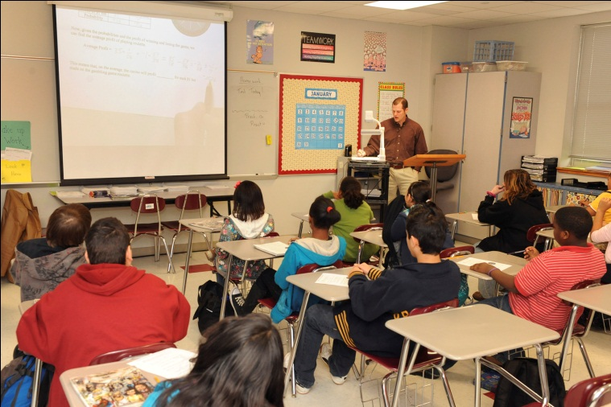
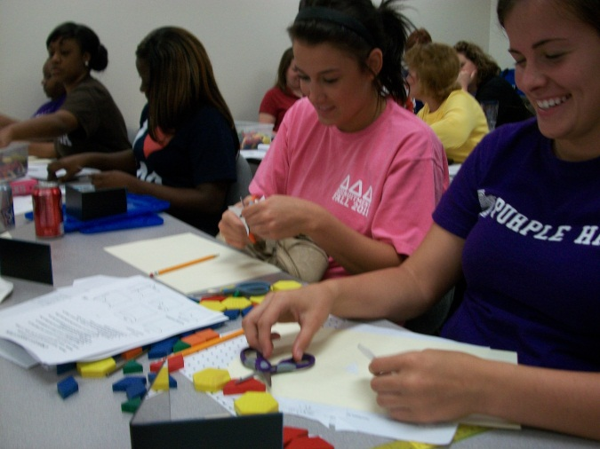
Reach Out …Keep them Interested …

Slide 40
Reaching out to teachers … Preservice and Inservice
Via NSF-funded Projects
17 STEM Undergrads shadow STEM master teachers
14 CAMT Sessions led by Master Teaching Fellows
24 Master Teaching Fellows complete leadership training
12 STEM Undergrads mentor HS students at NASA

Slide 41
College Access and Completion/Student Success
In recent decades, college access continues to climb while completion remains stagnant.
Although the U.S. ranks third in the percentage of 55-64 year-olds that hold a college degree, the 25-34 year-old age group ranks a disappointing twelfth.
To meet the increase in careers/jobs that require a postsecondary degree, IHEs must address issues of college completion.
AASCU, 2012

Slide 42
Our response …Active recruitment
SFA College | 2012-13 First time Fr. | 2012-13 Transfer | 2012-13 Total
Business | 305 | 105 | 410
Education | 402 | 267 | 669
Fine Arts | 157 | 53 | 210
Forestry & Agriculture | 114 | 57 | 171
Liberal & Applied Arts | 463 | 171 | 634
Sciences & Mathematics | 680 | 144 | 824

Slide 43
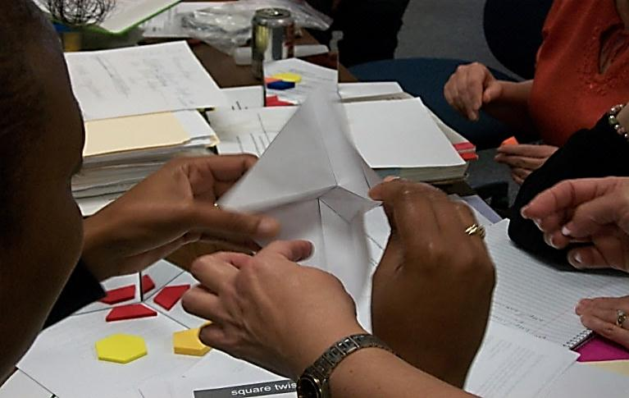
Students “Doing” Mathematics and Science
Keeping them Engaged …
Student Focused Instruction
Quality Teacher Preparation
Interactive Learning

Slide 44
Assessment The Accountability Movement
The assessment of student learning begins with educational values.
Assessment is most effective when it reflects an understanding of learning as multidimensional, integrated, and revealed in performance over time.
Assessment works best when the programs it seeks to improve have clear, explicitly stated purposes.
Assessment works best when it is ongoing not episodic.
Assessment makes a difference when it begins with issues of use and illuminates questions that people really care about.
AAHE Assessment Forum, FIPSE, Exxon Education Foundation, 2011

Slide 45
Our Response …
Streamlined & Efficient
Aligns college units under college goals
Addresses what we care about
Evaluates core, program, and unit objectives
CoSM Assessment Protocol

Slide 46
Interdisciplinary Programs and Experiences
The Center on Education and the Workforce: more college graduates need “STEM competencies” for employment and for lifelong wellbeing
The multi-faceted, unscripted, and borderless challenges of the future--food and water, energy, disease prevention, economic disparities, climate change, conflict and nuclear proliferation—present an urgent set of issues for higher education.
How do we move successful models already developed from niche to norm?

Slide 47
Our Response …
Interdisciplinary Programs
Graduate
Undergraduate
Ideas??
M.S. in Natural Sciences
M.S. in Mathematical Sciences

Slide 48
Note:
Fiscal constraints will almost certainly lead to program, department and school–level eliminations. As resources diminish, the ability of strong programs to carry those who cannot cover their operational costs diminishes, resulting in the difficult decision of discontinuation and/or mergers.
Purdue University, 2011

Slide 49
Discover the World around you – visit the SFASU Discovery and Research Center
A community-wide resource that provides an enjoyable learning experience promoting curiosity, discovery, and innovation.
A showcase of exhibits associated with cross-disciplinary learning and research.
A collection of interactive exhibits and programs developed by SFASU faculty and students.
Home of the SFASU East Texas Core Repository for storing and viewing core samples. The East Texas Geological Society will donate oilfield core samples drilled in the East Texas region.

Slide 50
Alternate Funding Sources
2011 marked an all time low point in state funding for public colleges and universities with hundreds of millions of dollars in funding cuts, combined with increasing student enrollments. Per-student funding reached an all time low. The impact on college and university funding is profound.
American Association of State Colleges and Universities, 2012

Slide 51
Our Response …
External Grant Acquisition
Business & Industry Funding Sources
Private Donor & Foundation Sources
Widen the external funding pipeline through increased attention to:

Slide 52
Research Grant Activities - Teacher/Student Focused
Texas Middle and Secondary Mathematics Project:
Leadership Initiative, Math/Science Partnership
Texas Leadership Initiative:
Mathematics Instruction Transformed
Talented Teachers in Training for Texas (T4)
Statewide At-Risk Tracking and Intervention Program for Nursing Students
Math, Science, Technology Teacher Preparation Academy

Slide 53
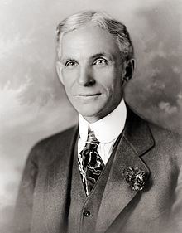
Issues/Trends … Where Do We Go From Here?
“If everyone is moving forward together, then success takes care of itself.”
Henry Ford, American Industrialist

Slide 54
College Readiness/Common Core State Standards – STEM Center Faculty Advisory Committee
Dr. Matt Kwiatkowski – Biology
Dr. Michael Janusa – Chemistry/Biochemistry
Dr. Wes Brown – Geology
Dr. Jane Long – Mathematics/Statistics
Dr. Sara Bishop –Nursing
Dr. Walter Trikosko – Physics/Astronomy

Slide 55
College Access and Completion/Student Success – College Council
Biology : both slots open
Chemistry/Biochemistry: Dr. Arlen Jeffery and _______
Geology: Dr. Wes Brown and _____
Mathematics/Statistics: Dr. Clint Richardson and ______
Nursing: Ms. Michelle Klein and ______
Physics/Astronomy: Dr. Dan Bruton and _____

Slide 56
Assessment – College Assessment Committee
Dr. Rob Wiggers – Biology
Dr. Anthony Duben – Chemistry/Biochemistry
Ms. Mindy Shaw-Faulkner – Geology
Dr. Brian Beavers – Mathematics/Statistics
Dr. Rose Powell – Nursing
Dr. Norm Markworth – Physics/Astronomy

Slide 57
Interdisciplinary Programs and Experiences - Chairs
Dr. Dennis Gravatt – Biology
Dr. Michael Janusa – Chemistry/Biochemistry
Dr. Kenneth Farrish – Geology
Dr. Debbie Pace – Mathematics/Statistics
Dr. Glenda Walker – Nursing
Dr. Harry Downing – Physics/Astronomy

Slide 58
Non-state Funding Sources … Dean’s Advisory Board
Dr. Thomas Atchison – SFA Former Dean of CoSM
Mr. Gary Stokes – CEO, Nacogdoches Medical Center
Mr. Scott Thompson – Lockheed Martin
Ms. Kris Owens – Merrill Lynch
Mr. Roy Knight – Lufkin ISD Superintendent
Mr. Fred Hayes – Nacogdoches ISD Superintendent
Mr. Joe Max Green – CEO, Bancorp South Insurance
Dr. Aaron Polk – Private Practice Medicine
Mr. A. L. Mangum – SFA Foundation
Mr. Bill King – President & CEO, NEDCO

Slide 59
A time to reflect …
Thank You!
Linda Stovall

